Slide 1
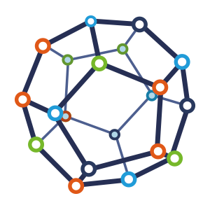


Computer Network
Class VI
lab 3

Slide 2
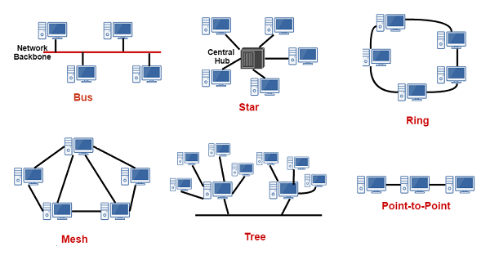
Network Topology
Network Topology refers to layout of a network

Slide 3
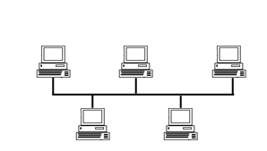
Bus Topology
In networking a bus is the central cable. The main wire, that connects all devices on a local-area network (LAN)

Slide 4
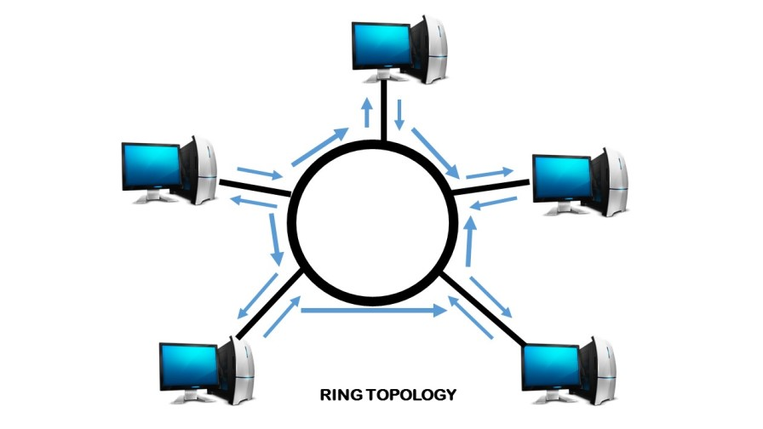
Ring Topology
all of the nodes are connected in a closed loop

Slide 5
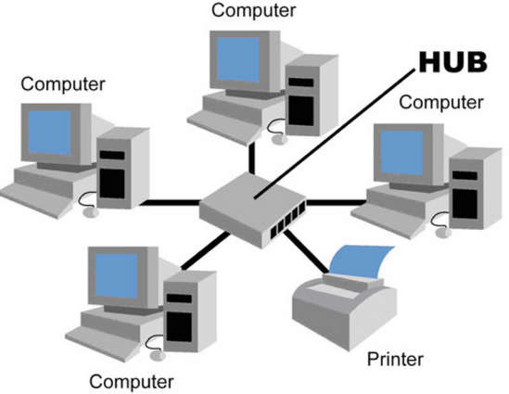
Star Topology
network devices are connected to a central computer, called a hub

Slide 6
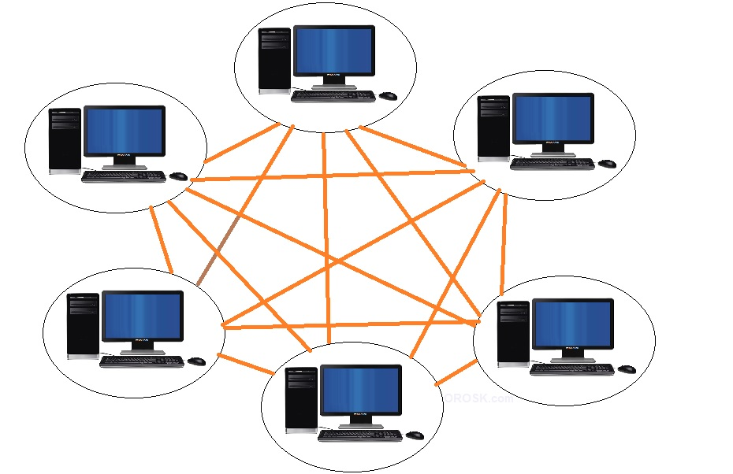
Mesh Topology
devices are connected with many redundant interconnections between network nodes

Slide 7
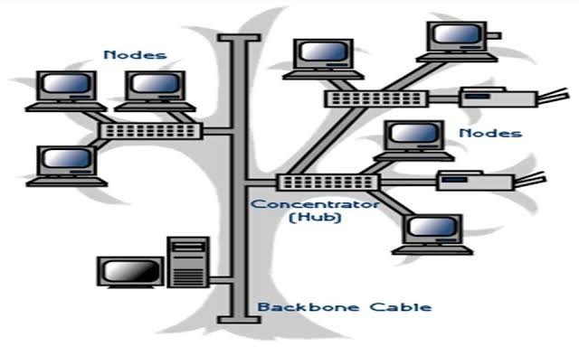
Tree Topology
This is a "hybrid" topology that combines characteristics of linear bus and star topologies

Slide 8



